Slide 1
K-Nearest Neighbors (KNN)
Popular in clinical sector

Slide 2
Introduction
Definition:
K-Nearest Neighbors is a lazy learning algorithm used for classification and regression tasks. It predicts the output for a new data point based on the majority class (for classification) or the average value (for regression) of its nearest neighbors.
Key Characteristics:
Non-parametric: KNN does not make any assumptions about the underlying data distribution.
Lazy learning: KNN does not learn a discriminative function from the training data but memorizes the training dataset instead.
Where discriminative function in the context of machine learning is a function that differentiates between different classes based on the input features.

Slide 3
KNN is a versatile and intuitive algorithm for both classification and regression tasks.
While it is easy to understand and implement, its performance can be significantly impacted by:
The choice of K,
The distance metric used, and
The presence of irrelevant or high-dimensional features.
Proper preprocessing, including feature scaling and dimensionality reduction, can help mitigate some of these issues.

Slide 4
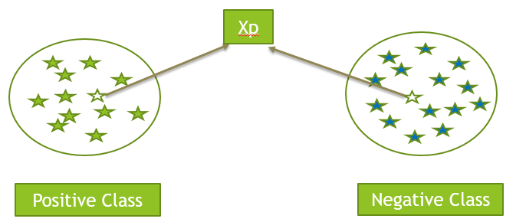
Geometric Intuition:
Let us have a 2d data set for understanding as we can easily visualize it and we have two class positive and negative.
Now we have an observation(Xp) and want to decide whether it is positive or negative.
It is lies close to positive we can say it is positive and if it is close to negative we can say it is negative.

Slide 5
Failure cases of KNN
So objective is to find the class of the given input based on the K nearest point in data set, and based on voting decide the class.
Total number of K = Square root of total records.
Generally take the value of ‘K’ as odd number.(3,5,7, etc). It makes the decision making easy based on Majority class.
If point to be classified is far away or outlier than we can not use KNN.
Xq
If distance is too large

Slide 6
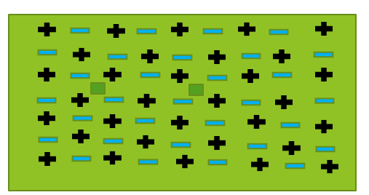
If data is jumbled or mixed like this:
So we can say KNN is simple to understand.
Very Fast and Efficient model.
Is gives good results for classification problems.
Don’t use it for regression problem.
It is domain specific algorithm used for clinical sector data set.
If data is less than(1000) use KNN.

Slide 7
Distance Measures
But problem is need to choose number of neighbors “K” because as K changes our answer can also changes so to find optimum number of ‘K’ is always challenging.
Since we are saying that we need to measure distance than let us discuss of certain fundamental rules to measure distance. However we have discussed in Linear Algebra but again recap here.
Distance measures:
Euclidean Distance(L2 norm) : 99% time we use in KNN
Manhattan Distance (L1 norm)
Minkowski Distance (Lp norm)
Hamming Distance
Cosine Distance

Slide 8
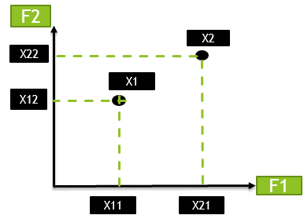

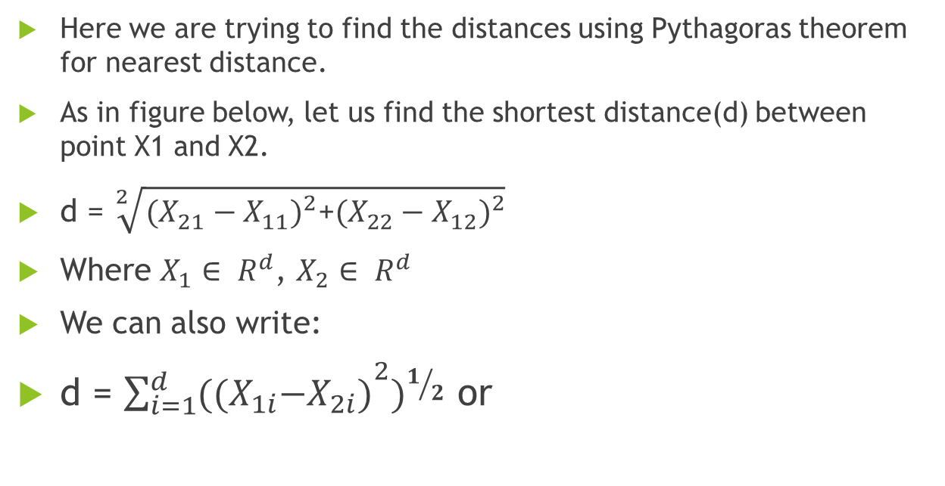
Euclidean Distance(L2 norm)
Here we are trying to find the distances using Pythagoras theorem for nearest distance.
As in figure below, let us find the shortest distance(d) between point X1 and X2.
d = $\sqrt[2]{{(X_{21}−X_{11})}^{2}\text{+}{(X_{22}−X_{12})}^{2}}$
Where $X_{1}∈ R^{d}$, $X_{2}∈ R^{d}$
We can also write:
d = ${{\sum_{i=1}^{d}{{((X}_{1i}−X_{2i})}}^{2})}^{1/2}$ or

Slide 9
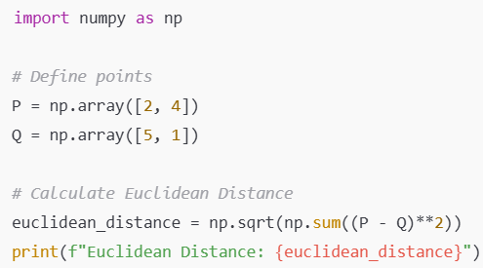

Slide 10
Characteristics of Euclidean Distance
Straight-Line Distance:
Measures the direct (diagonal) distance between two points.
Correlation with Geometry:
Represents the geometric distance in standard Cartesian coordinates.
Sensitivity to Scale:
Features with larger scales dominate the distance calculation.
Normalization or standardization is required to ensure fair comparison between features.
Outlier Sensitivity:
Squaring the differences in coordinates makes Euclidean Distance sensitive to outliers.

Slide 11
Manhattan Distance
Manhattan Distance measures the distance between two points by summing the absolute differences of their coordinates.
It is also known as L1 Norm or Taxicab Distance because it resembles the path a taxi would take in a grid-like city layout (e.g., moving along streets and avenues instead of diagonally).
Manhattan Distance follows axis-aligned paths.

Slide 12
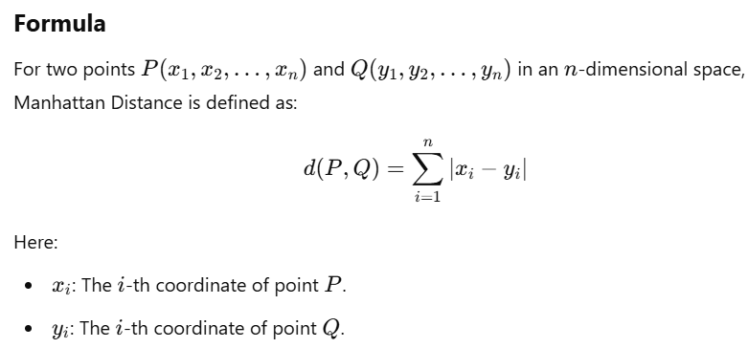

Slide 13
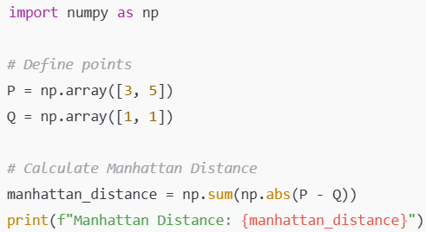

Slide 14
Characteristics of Manhattan Distance
Non-Euclidean:
Unlike Euclidean distance, which measures the straight-line (diagonal) distance, Manhattan Distance follows axis-aligned paths.
Insensitive to Outliers:
Since it considers absolute differences rather than squared differences, it is less affected by extreme values compared to Euclidean distance.
Feature Scaling:
It is sensitive to differences in feature scales, so normalization or standardization is crucial when using Manhattan Distance.
Use Cases:
Often used in high-dimensional spaces where diagonal distances (as in Euclidean distance) lose interpretability.
Suitable for problems where movement or differences occur in orthogonal directions (e.g., city navigation).

Slide 15
When to Use Manhattan Distance in KNN
High-Dimensional Data:
It works better than Euclidean distance in high-dimensional spaces because it doesn’t overly penalize differences along any single axis.
Sparse Data:
For datasets where many features are zero (e.g., text data represented as term frequency vectors), Manhattan Distance is often preferred.
Categorical Features:
When used with dummy encoding, Manhattan Distance can effectively measure differences in categorical data.

Slide 16
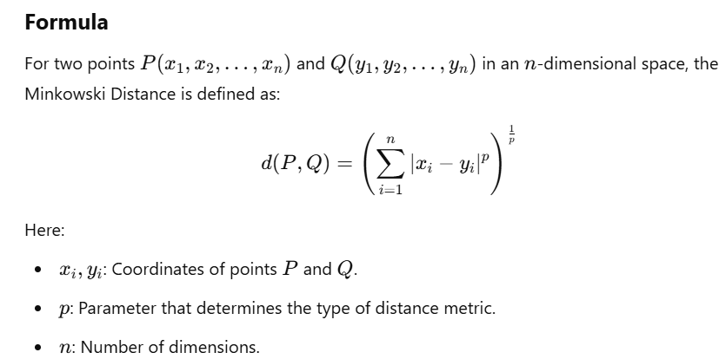
Minkowski Distance(LP Norms)
Minkowski Distance measures the distance between two points in an n-dimensional space.
It generalizes both Euclidean and Manhattan distances through the parameter p.

Slide 17
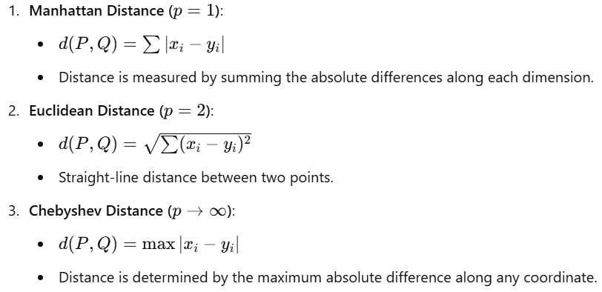
Special Cases

Slide 18
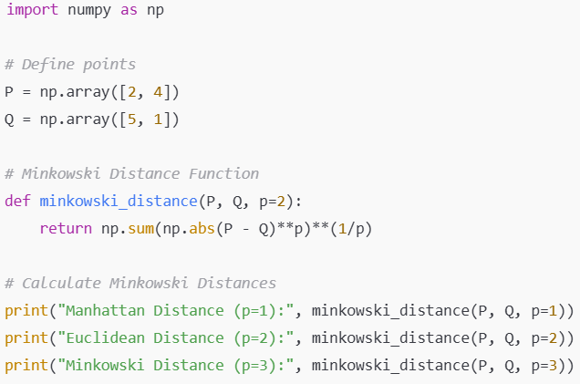

Slide 19
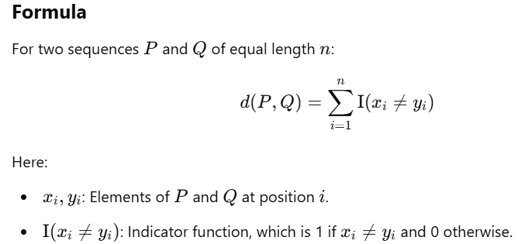
Hamming Distance
Hamming Distance is a distance metric used primarily for comparing categorical or binary data or Boolean vector.
It measures the number of positions at which the corresponding elements of two sequences (strings, vectors, or arrays) differ or mismatched.
In NLP When we need to find distance between texts than we use Hamming Distance.(BOW/ TF-IDF)

Slide 20
Example Calculation
For Binary Data:
Consider two binary sequences: P=[1,0,1,1], Q=[1,1,0,1]
Hamming Distance:
d(P,Q)=(1≠1)+(0≠1)+(1≠0)+(1≠1)
Step-by-step:
Compare each position: 0,1,1,0
Count mismatches: 2
d(P,Q)=2, Means hamming distance is 2

Slide 21
For Categorical Data:
Consider two sequences of letters: P=[′A′,′B′,′C′,′D′] , Q=[′A′,′B′,′D′,′D′]
Hamming Distance:
d(P,Q)=(A≠A)+(B≠B)+(C≠D)+(D≠D)
Step-by-step:
Compare each position: 0,0,1,0
Count mismatches: 1
d(P,Q)=1 , Means hamming distance is 1

Slide 22
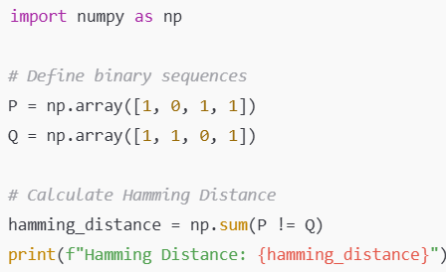
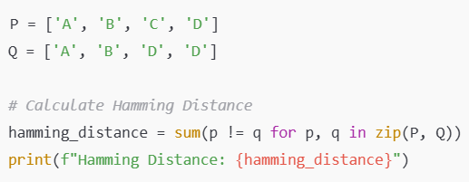

Slide 23
When to Use Hamming Distance in KNN
Data is binary (e.g., presence/absence features).
Data is categorical, and one-hot encoding is used.
Comparing text strings or DNA sequences.

Slide 24
Cosine Distance and KNN
Cosine distance is a metric used in K-Nearest Neighbors (KNN) to measure the dissimilarity between two non-zero vectors in a high-dimensional space.
It is particularly effective for datasets where the magnitude of the vectors is less important than their orientation (e.g., text data, document similarity).
Cosine distance measures the angular difference between two vectors. It is derived from the cosine similarity, which quantifies the cosine of the angle between two vectors.
Popular in Recommendation system and Text classification.

Slide 25
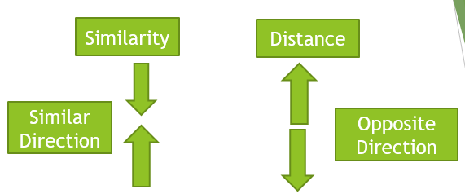
Cosine Distance(X1,X2)=1−cos(θ)
Where θ is angle between X1 and X2
For very similar cos(θ) = +1
For very dissimilar = -1

Slide 26
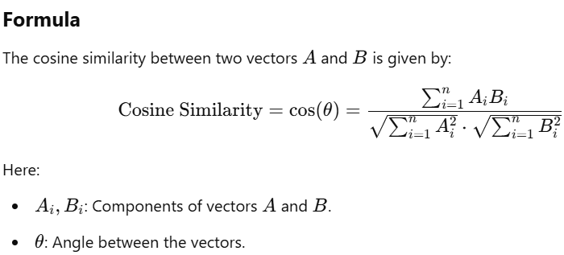

Slide 27
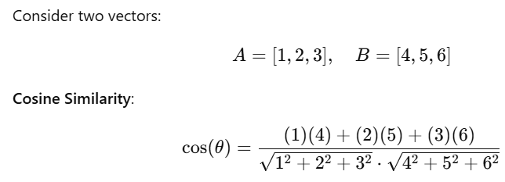
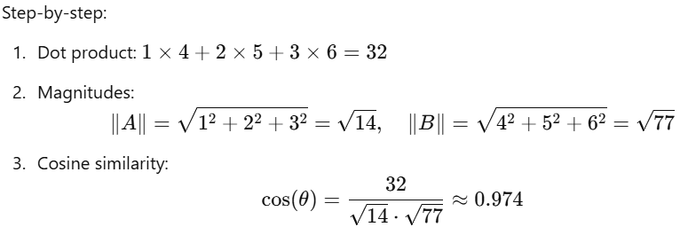
Example Calculation

Slide 28
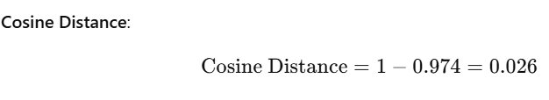
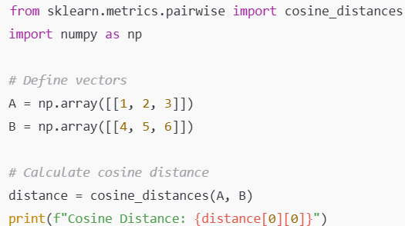

Slide 29
Limitation:
It is lazy algorithm. According to this If my neighbors millionaire than I am also millionaire.
It is good for clinical sectors only. Because there is some threshold which is applicable to all.( hemoglobin, sugar level, BP, Cholesterol etc….

Slide 30
How you will calculate K value
Understand the Role of K:
Small K: Can lead to noisy decision boundaries and overfitting.
Large K: Can lead to smoother decision boundaries but might underfit the data.
Thus badly needed Optimal K:
Step 1: A typical starting point is K= sqrt(n)​, where n is the number of training samples.
Round K to the nearest odd integer to avoid ties in classification tasks.

Slide 31
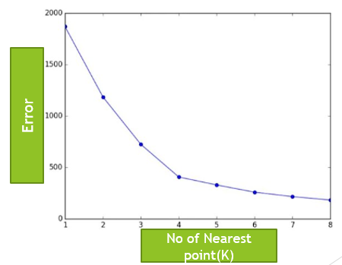
Step 2 : Elbow Method (for Classification)
Plot the accuracy/error rate against different K values.
Look for the "elbow point" where the error decreases significantly before stabilizing. This is often the optimal K.

Slide 32
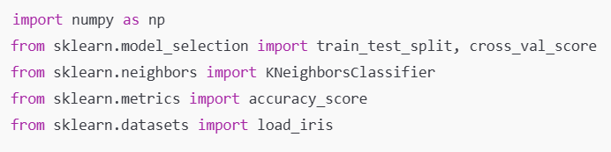
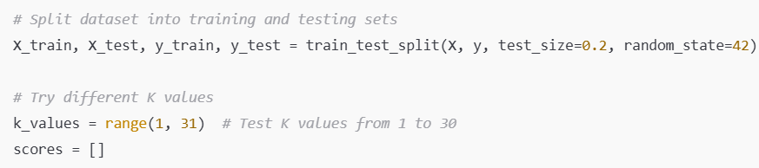
3. Automate K Selection with Code (Grid Search):

Slide 33
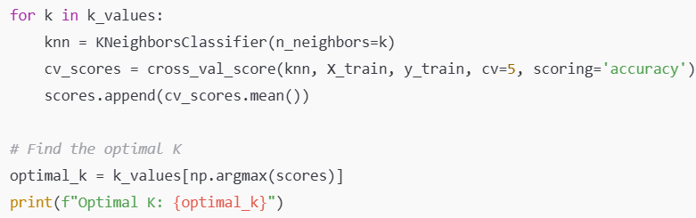
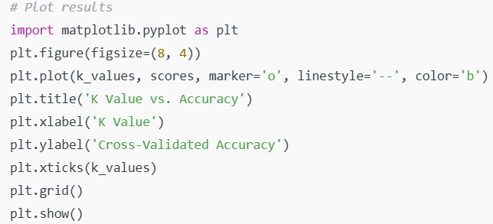

Slide 34
Problem with KNN : Overfitting or Under fitting: Cross-Validation
What is Cross-Validation?
Cross-validation involves partitioning the dataset into multiple subsets, training the model on some subsets (training set) and evaluating it on the remaining subset (validation set).
The process is repeated several times with different partitions, and the results are averaged to obtain a more reliable estimate of the model’s performance.

Slide 35
Steps to Apply Cross-Validation with KNN:
Split the Data: Divide the data into 𝐾 folds.
Train and Validate:
For each fold, train the KNN model on 𝐾−1 folds and validate it on the remaining fold.
Calculate the performance metric (e.g., accuracy for classification, mean squared error for regression).
Average the Results: Average the performance metrics from all folds to get an overall performance estimate.
Parameter Tuning:
Repeat the process for different values of 𝐾 (the number of neighbors).
Select the 𝐾 that gives the best average performance across the folds.

Slide 36
How KNN Works
Choose the number of neighbors (K):
This is a hyper-parameter that determines how many neighbors to consider when making a prediction.
Calculate the distance:
Use a distance metric (e.g., Euclidean distance) to find the distance between the query point and all points in the training set.
Identify the K-nearest neighbors:
Select the K data points that are closest to the query point.
Make a prediction:
For classification: Use majority voting among the K-nearest neighbors.
For regression: Take the average of the values of the K-nearest neighbors.

Slide 37
Applications of KNN
Classification: Handwriting detection, image recognition, etc.
Regression: Predicting house prices, stock market trends, etc.
Imputation: Filling in missing values in datasets.

Slide 38
Practical Tips
Feature Scaling:
Always standardize or normalize your features when using KNN because it is sensitive to the scale of the data.
Handling Imbalanced Data:
Consider using weighted KNN where closer neighbors have a higher influence.
Dimensionality Reduction:
Techniques like PCA can be used to reduce the dimensionality of data to improve the performance of KNN.

Slide 39
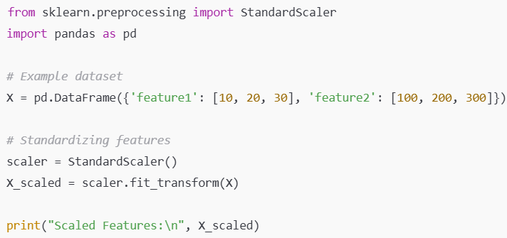

Slide 40

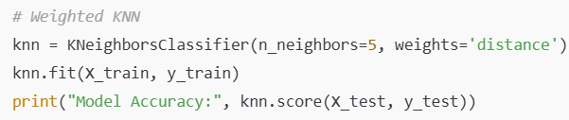
# Example dataset
X, y = make_classification(n_classes=2, weights=[0.1, 0.9], n_informative=3, n_samples=1000, random_state=42)
X_train, X_test, y_train, y_test = train_test_split(X, y, test_size=0.2, random_state=42)
# 'distance' gives higher weight to closer neighbors

Slide 41
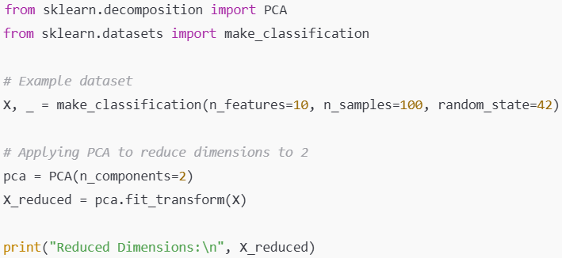

Slide 42
Advantages and Disadvantages
Advantages:
Simple and easy to understand.
No assumptions about data distribution.
Naturally handles multi-class classification.
Disadvantages:
Computationally expensive during prediction.
Performance can degrade with high-dimensional data (curse of dimensionality).
Sensitive to the scale of data and irrelevant features.

Slide 43
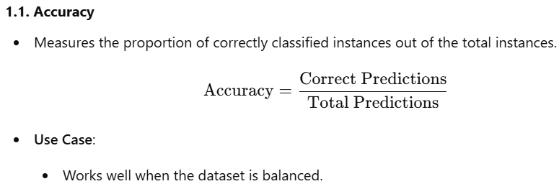

Evaluation Metrics for KNN

Slide 44
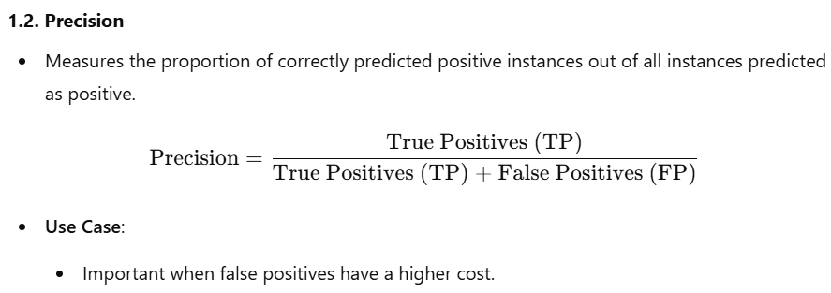


Slide 45
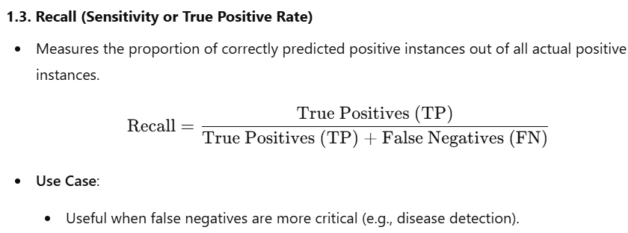
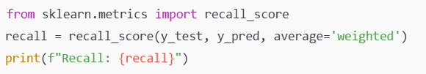

Slide 46
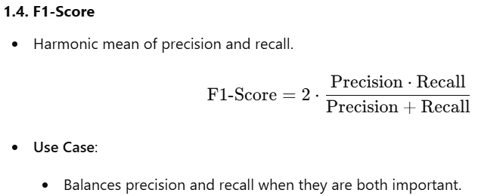
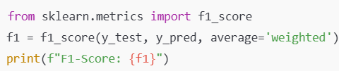

Slide 47
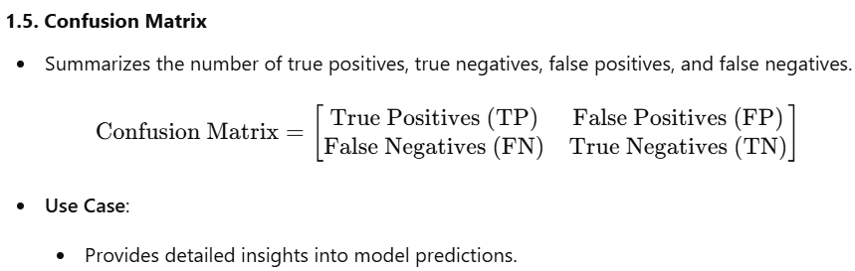


Slide 48
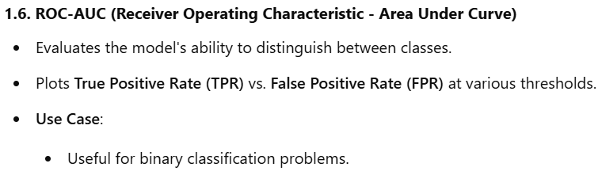


Slide 49
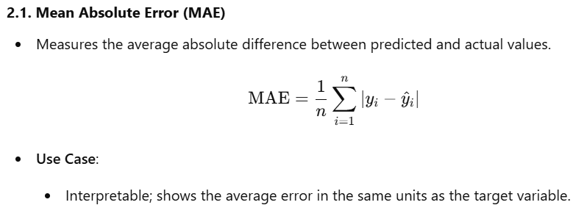

2. For Regression

Slide 50
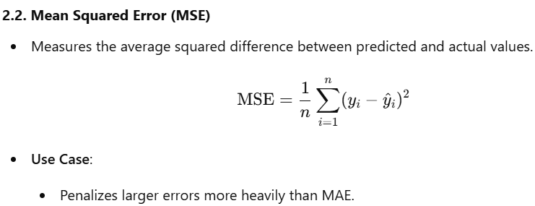


Slide 51
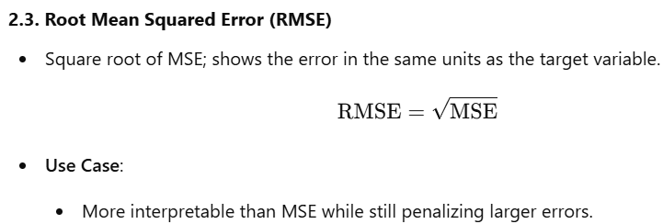


Slide 52
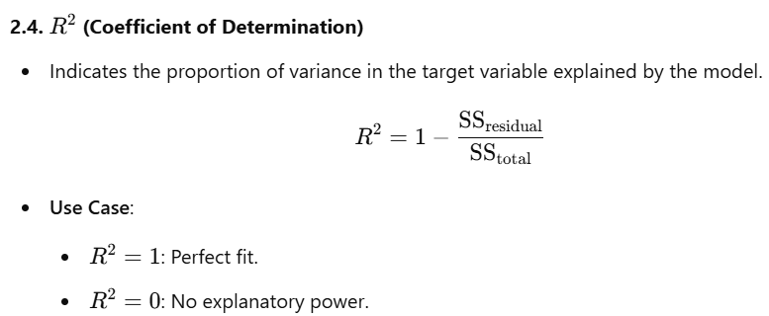


Slide 53
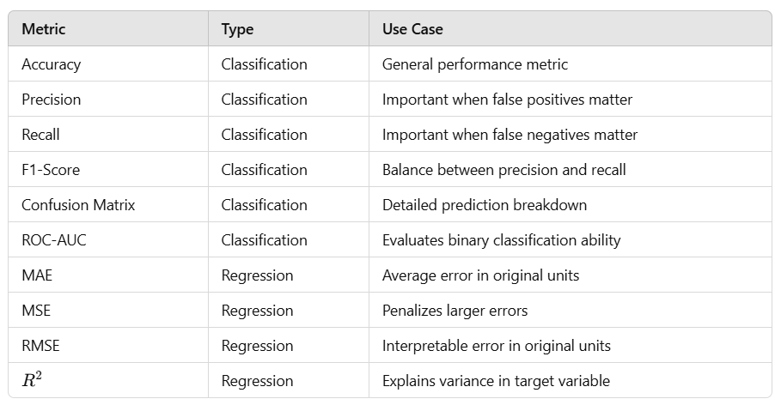
Summary Table

